Slide 1
Role Aware Financial Insights Assistant
AI System for Tailored Financial Insights Across User Roles
Team: Finsight
Members:
Aishly Manglani
Syeda Nida Khader
MohibKhan Pathan
Siri Batchu

Slide 2
Problem Statement
What is the problem?
Financial data and documents are large, complex, and diverse
Traditional analysis takes time and specialized skills
Users in different roles (e.g., Executives, Analysts, Product Managers) need different insights
No single assistant customizes responses to user role context
Goal:
Build an AI assistant that dynamically adapts insights based on user role and context

Slide 3
Motivation
Why is this important?
Executives need strategic summaries
Product Managers need operational KPIs
Analysts need deep, granular metrics
Finance teams need benchmarks and comparison

Slide 4
System Overview
Structured & Unstructured Inputs
Financial reports
Spreadsheets
PDFs, tables, dashboards
Agentic RAG Pipeline
Ingestion
Retrieval
LLM reasoning and response generation

Slide 5
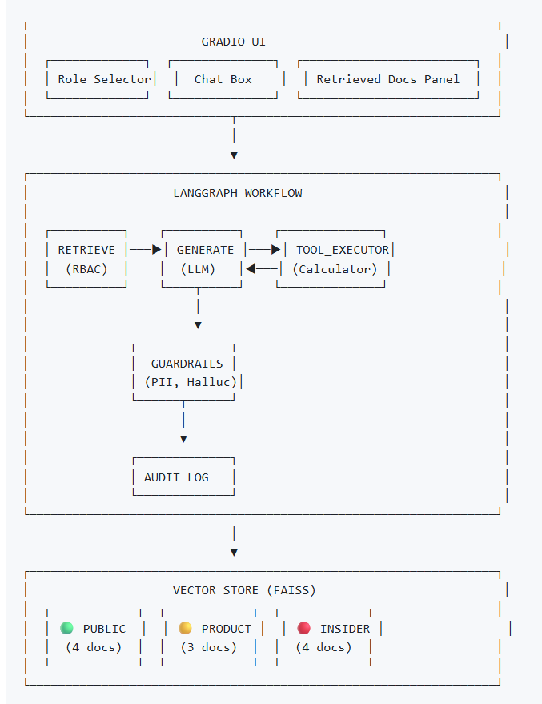
Role Context Layer
Executive
Product
Analyst
Operations
Output
Tailored insights and recommendations

Slide 6
Key Features
Ingest multiple data sources (PDFs, CSV, Excel)
Semantic retrieval over financial content
Role-based context adaptation
Agent orchestration for task routing
Plug-in benchmarking APIs for real-time data
Guardrails and RBAC for secure access

Slide 7
Agentic RAG Architecture
Data Ingestion Agent
Parses structured and unstructured documents
Extracts tables and graphs
Vector Store
Embeddings
FAISS or other semantic stores
Retrieval Agent
Searches relevant sections of documents
Role Context Agent
Modifies prompts based on user role
LLM Generator
Produces role-tailored output

Slide 8
Role Aware Explained
What is Role Awareness?
Role context affects:
Terminology used
Depth of analysis
Focus of insights
Examples:
Executive: Enterprise revenue trends
Product Manager: Growth metrics, churn drivers
Analyst: YOY variance and KPIs
Role context modifies the LLM prompt to match persona requirements.

Slide 9
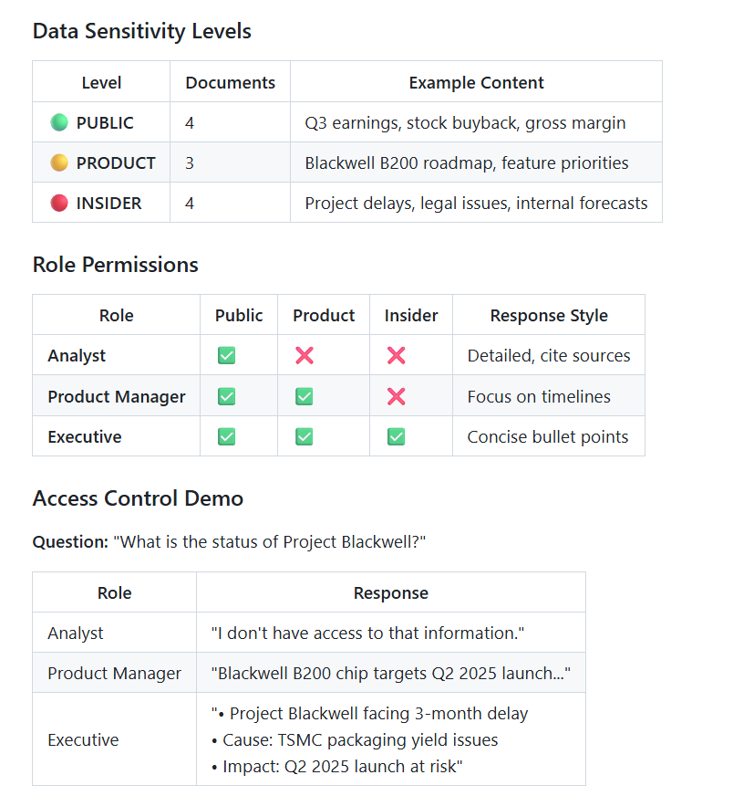
Role Based Access Control

Slide 10
Tech Stack
Backend
Python
FastAPI/Flask
Agent orchestration library (LangGraph/LangChain)
Frontend
Streamlit, React, or custom dashboard
Data Storage
Vector DB: FAISS, Chroma, Elasticsearch
Metadata store: MongoDB or PostgreSQL
LLM APIs
OpenAI

Slide 11
Demo

Slide 12
Conclusion
Role-Aware Financial Insights Assistant
Tailors outputs to user role
Reduces time for financial analysis
Combines retrieval + generative AI
Brings an internal financial analyst to every user.

